Slide 1
ASD – Autism Spectrum Disorder
Diagnose – and then?
Experiences from Sweden, Sockholm
Gun Persson Skoog, Marie Källström
Autismcenter for children and Adults
Gun Persson Skoog, Marie Källström
Autism center for children and adults

Slide 2
Agenda
ASD in Sweden – support from society after diagnose
Centres of ASD what do we do?
Lunch
Interventions – how?
Reflections and time for questions
Coffee break
Organized Aspergers
Paneldiscussion

Slide 3
Who are you?
Please stand up those of you who:
Work in the political arena
Work professionally with people with ASD
Have personal experience of ASD within your network or from volounterly work
Hope that this will be an interesting day

Slide 4
Who are we?
Habilitation and Health in Stockholm, Sweden
Autismcenter for children with ASD and MR

Slide 5
ASD - prevalence
6/1000 within the ASD-spectra
4/5 – normal IQ

Slide 6
After diagnose parents usually apply for:
      Support from school, (ex special assistent)
      Care allowance
      Support from social service (ex homeassitant)
      Support from Habilitation

Slide 7
Support from society
COUNTY COUNCIL
MUNICIPALITY
GOVERNMENT
Special care allowance
Habilitation centers and ASD centers
Consulting approach to parents and network
(schools etc)
Psychiatric centers
Diagnose Assesments/Medicine, Psyciatric treatment
Schools, living homes, daycare for adults
Responsible for special schools, special assistants
Support through for example: personal assistant, special grouphomes or daily activities
Private practices

Slide 8
Centres of ASD
Habilitation and Health
Central centres
Autismcenter for small children (0-6 years old)
Individualsupport and interventions
Education- and supportgroups
HC
HC
HC
Aspergercenter for
children (7– 18 years old)
Education- and support groups
Autismcenter for
children ASD+MR (7 – 18years old)
Individual support and interventions
Education- and support groups
HC
HC
HC
Aspergercenter for adults
Education- and support groups
Autismcenter for adults
ASD + MR
Individual support and interventions
Education- and suppportgroups
HC
ADHD-centre
Education- and supportgroups
HC

Slide 9
What do we do?
Contribute to the spreading of knowledge about ASD
Advice, support and interventions
Improve the situation as much as possible by preventing and decrease the difficulties that the disability can cause in everyday life.

Slide 10
How do we do it?
Advice, support and interventions
Information
Educational and Support groups
Individual support and interventions.

Slide 11
1) Information
Webb
Folders, broschures, H & H Library
Educations to parents and network
Telephonecounseling

Slide 12
2) Educational and support groups

Slide 13
Examples of groups for parents and network
Basic courses
Communication courses
Parental training programs
Groups for siblings, grandparents etc
Special focusgroups
(Sleep, Food, Cognitive support,
Support from society etc)

Slide 14
Examples of groups for people with ASD
Groups for children in different ages
(session with parents before and after )
Groups for adults about:
  The diagnose
  Everyday conversations
  Feelings
  Strategies in everyday living
  Relations
  Parenthood

Slide 15
Basic course for parents
4 sessions
Gives you knowledge about autism and practical guidance in everyday situations.
The course helps you to structure social interaction, support communication and to approach and prevent behavioralproblems
1. Presentation ASD & MR
2. Cognition & Perception difficulties
3. Communication, Social interaction, Behavior
4. Visual support

Slide 16
3) Individual support
Advice and support to parents,
interventions to the child /adult with ASD
Consultation to network (schoolteachers and assistants, staff in shortterm-homes/ grouphomes/ day services)
Coordination

Slide 17

Who are doing it?
Team of
Occupational therapists
Special education teachers
Speachpathologists
Counselers
Psycologists

Slide 18
Occ.therap.
Psychologist
Spec.educ.teach.
ASD, MR
ABA, TEACCH
Speech therap.
Counseler.

Slide 19
Form for assesment
Name __________________________________
Network_________________________________
Activities (play and social interaction)________________
Basic skills in everyday life (food, sleep, hygien, etc)_
Communication___________________________
Behavior (strengths and weeknesses)________________
Motoractivities____________________________
Perception (sight, sound, touch, smell, taste)___
Present Cognitive support __________________
Your request for support from Autismcenter)____

Slide 20
Habilitationprocess
Observation
In school
or at home
First visit
Usually just the parents
Careplan
With the parents
and - if possible- with the person
Educational
or supportgroups
Basic course

Slide 21
Care plan
Present: Parents and staff from Autismcenter
Current situation: Charlie , 12, ASD MMR, lives with his parents and younger sister. He is in an
ordinary school in a small group. He describes as having a bad temper acting out towards other classmates .
At home the biggest problem is to get him to school in time
Problems to prioritize Tantrums in school, morning situation
Maingoals: Decrease tantrums in school, Improve the situation in the mornings at home.
Support/Interventions: Further assesment in school and at home, Basic course to parents, group for siblings to Charlies sister
Evaluation In six months

Slide 22
Individual support
End
Indivudual
support/
counseling
1 – 10 times
Evaluation of the
Careplan
New careplan

Slide 23
Autism
Characterised by severe and pervasive impairments in several important areas of development:
-communication
-reciprocal social interaction
-behavior and imagination

Slide 24
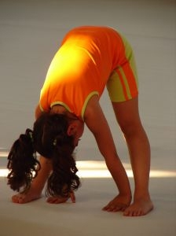
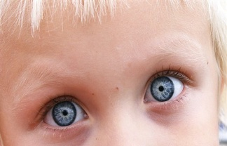
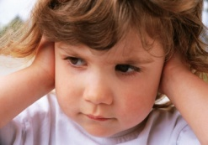

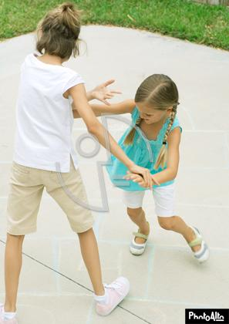

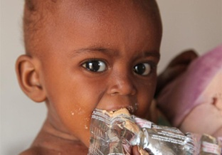
Autism and the senses
Sight, sound, touch, smell, taste,
balance & body awareness

Slide 25
The base of education
Autism
Mental Retardation
ABA
Visual and cognitive
support (TEACCH)

Slide 26
Specially-tailored educational strategies
ABA strategies (Applied behaviour analysis)
TEACCH-model (Treatment and Education of Autistic and related Communication Handicapped Children)

Slide 27
ABA – Applied behavior analysis
Applied behavior analysis is a sience devoted to
the understanding and improvement of human behavior.
ABA is a scientific approach for discovering environmental variables that reliably influence socially significant behavior and for developing a technology of behavior change that takes practical advantage of those discoveries.
(Cooper, Heron, Heward, 2005)

Slide 28
ABA
A method of teaching children with autism and Developmental Disorders
Based on the premise that appropriate behavior – including speech, academics and life skills – can be taught using scientific principles
Assumes that children are more likely to repeat behaviors or responses that are rewarded

Slide 29
TEACCH – Treatment and Education of Autistic and Communication related handicapped CHildren
An evidence-based service, training and research program for individuals of all ages and skill levels with autism spectrum disorders.
The TEACCH-method are based on the premise that people with autism are predominantly visual learners
Focus on physical and visual structure

Slide 30
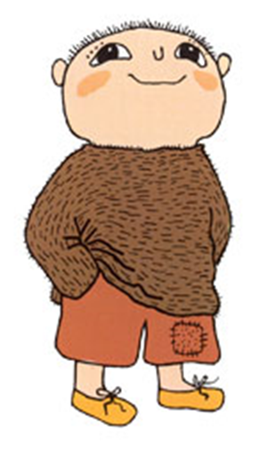
Where to be, what to do and how to do it, all as independently as possible
For how long?
What am I going to do?
With whom shall I be?
Where shall I be?
What shall I do next?

Slide 31
Learning abilities
All people learn things according to the same principles
You learn from your own experience
The persons presumption and surroundings is the settlement for what we are going to learn

Slide 32
ASD – learning abilities
Another way of learning
Learning in small steps
A thousand times (repetations)
Visual support (pictures, schedules)

Slide 33
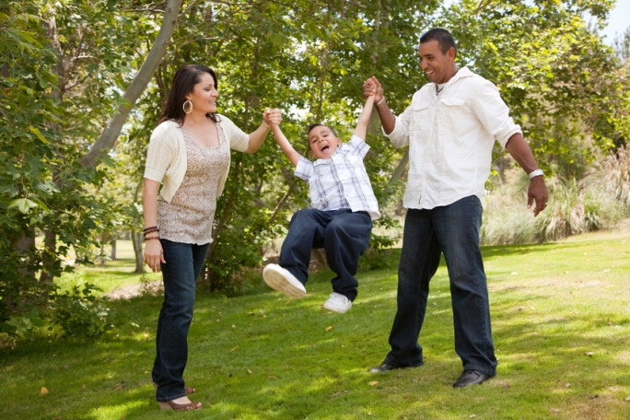

Who is going to do the work?
Parents
Siblings
Family members/relatives
Schoolteachers
Assistens

Slide 34
Common areas of Interventions
Communication
ADL:
Sleeping, Eating, Toileting, Dressing, Hygiene
3. Behavior

Slide 35
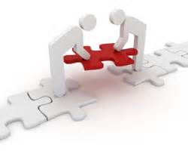
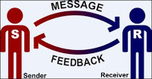
1.Communication
The exchange of information between two people or more.
A possibility to express desires or wishes and get something in return

Slide 36
You need this to communicate!
A partner – with whom?
A method – how?
A reason – why?

Slide 37
Augmentative & alternative communication (AAC)
PECS - (The Picture Exchange Communication system)
Picture card sheets
Signlanguage

Slide 38
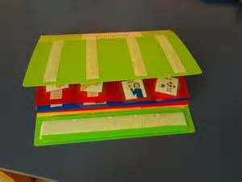
PECS

Slide 39
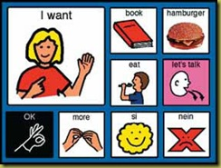
Picture-cards/sheets

Slide 40
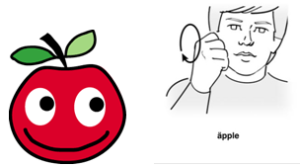
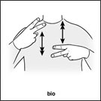

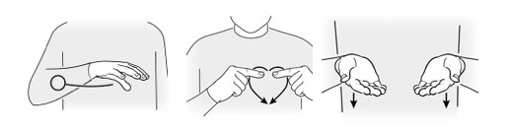
Sign language

Slide 41
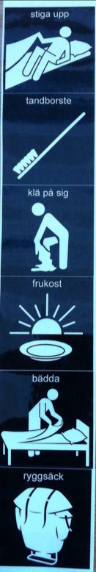
2.ADL
Routines
Dressing
Tooth-brushing
Showering
Eating
Toileting
Transitions
Play and leisure time/Activities

Slide 42

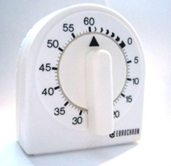
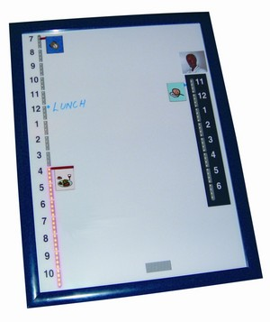
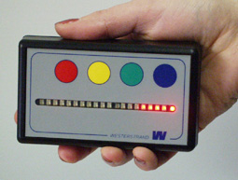
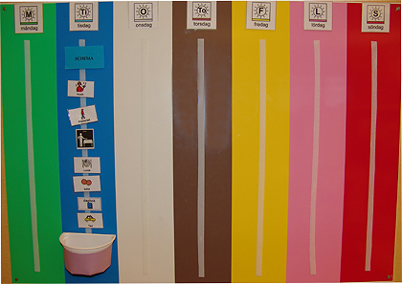
Accomodation/Support
Schedules
Visual timers

Slide 43
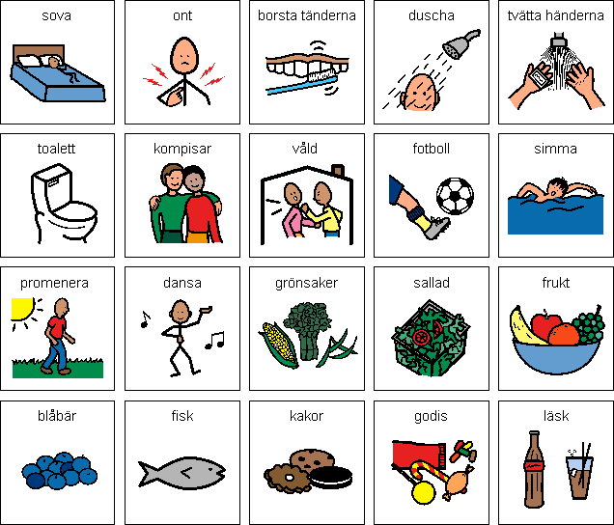
Visual support

Slide 44

Social story ”To shower”
Everybody takes showers
I also need to take showers
To shower is a good thing because then I feel clean.
It is hard for me to know when I need to shower and how to do it.
Mum tells me when its time to shower.
The schedule show me how to do it.
The schedule is on the wall next to the shower
When I have taken a shower I smell good
Mum, dad and my sisters think it´s nice.
When I have taken a showr I feel good.

Slide 45
Sleeping difficulties
Behavior
hard to go to bed
sleeps in the parents bed
________________________________________________
underlying
factors
worried, lightsleeper
afraid to fall asleep by himself

Slide 46


Assessments and Interventions
1.Sleep registration (day & night for one week)
2.Adjustments and interventions
- social story
- sleep training/program
- blanket
Medicine ?

Slide 47
3.Behavior
Expectation - Ability
Expectations from surrondings
Abilities

Slide 48
Functional assessment
Definitions and functions
- deficits and excesses
Behavior registration
Analysis
Assessment and intervention plan

Slide 49
Registration form/paper
Description of the behavior we want to observe.Tantrums in school.......
When Day and time | Situation Where, with whom, activities | Behavior How long (1-10) How strong | Consequences Reactions, what did the child, others

Slide 50



Tokens
Pinpoint behaviors to be changed
Build a token economy
Implement the program

Slide 51
Summery and experiences
Important to reach the people close to the child (ex parents, school) with information and consultation about ASD and the special methods that are needed.
Sometimes educational - and support groups can be initiated and, with professional support, be self sufficient
All people with ASD can develop and learn if they get a chance under right conditions and with the right adjustements. Small adjustements can help a lot.

Slide 52
More information - webb
www.habilitering.se/autismcenter-barn-och-ungdom
www.habilitering.se/autismcenter-vuxna
www.habilitering.se/autismcenter-sma-barn
www.habilitering.se/aspergercenters-barn-och-ungdomsteam
www.habilitering.se/adhd-center
www.autismforum.se
www.habilitering.se
www.habilitering.se/forum-funktionshinder
www.autism.se

